Slide 1
인턴십에서 배운 것
2019 01 02 ~ 2019 01 18

Slide 2
목차
Scratchapixel
Definition of CG
Overview of the Ray-Tracing Rendering Technique
Ray-Tracing Generating Camera Rays
A Minimal Ray-Tracer Rendering Simple Shapes
(Sphere, Cube, Disk, Plane, etc.)
Ray Tracing Rendering a Triangle
Polygon Mesh
Transforming Objects using Matrices
→ Nori
Normal vector, Bunny.obj rendering
Octree Construction

Slide 3
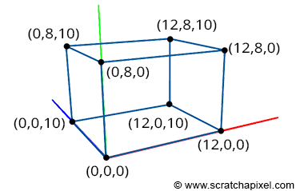
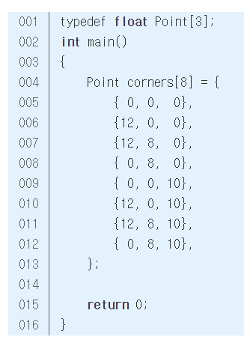
Definition of CG
Painter vs. Graphic engineer?
Describe the shape
어떤 점의 위치는 origin과의 거리(->coordinate) 로 표현.
Coordinate sys.
Rendering: the process of generating images
Simulate: motion of fluids, soft and rigid bodies
Scene: collection of objects (+ camera, lights)
Model: an object
Topology: how points are connected to each other to form faces (flat surfaces)
Vertices: points
Polygons: faces
(Polygonal) mesh: set of polygons
Perspective projection: project the corners of an obj. onto an imaginary canvas

Slide 4
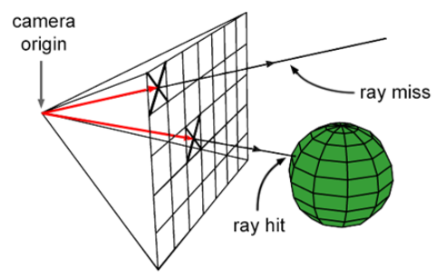
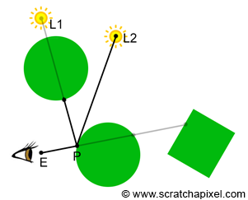
Ray-tracing
Visibility problem에 사용된다
Casting Rays:
cast a ray for each pixel in the image
2) Ray-Geometry Intersection:
test if a ray intersects any of the objects in the scene
(this requires to loop over all the objects for each cast ray).
3) Shading:
find out what the object "looks like" at the intersection point
between the ray and the object (if an intersection has occurred).

Slide 5
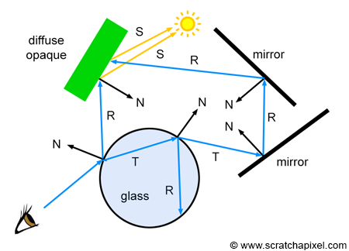
Whitted Ray-Tracing
Backward tracing
Reflection, refraction도 색 계산에 반영 가능
교점이 생기는 표면의 재질에 따라
해당 물질의 색 계산에 다른 방식을 사용한다.
opaque, diffuse → Phong model
Mirror like → trace reflection ray
Transparent(glass, water)
→ trace reflection, refraction ray

Slide 6
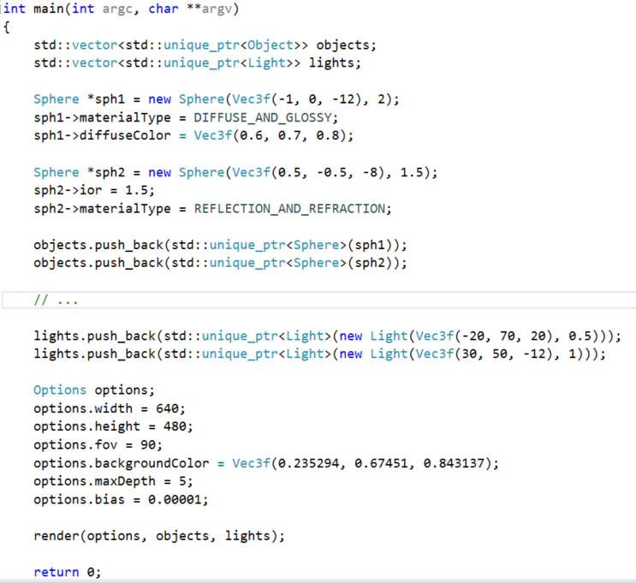
Whitted Ray-Tracing

Slide 7
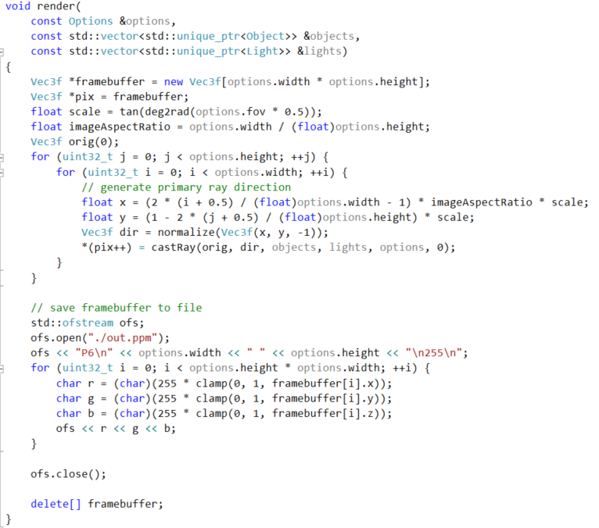
Whitted Ray-Tracing

Slide 8
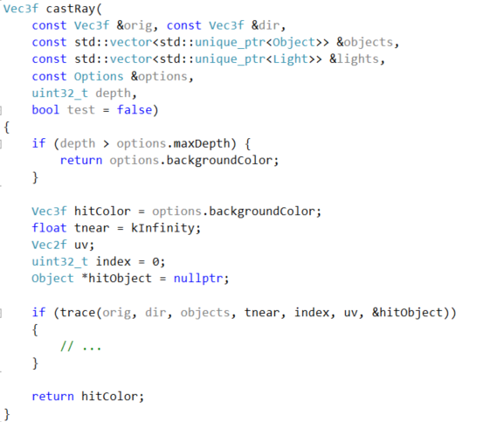
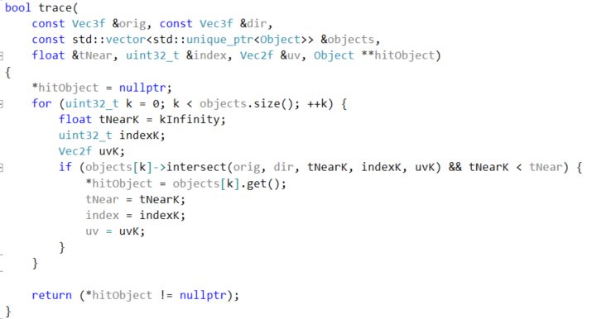
Whitted Ray-Tracing

Slide 9
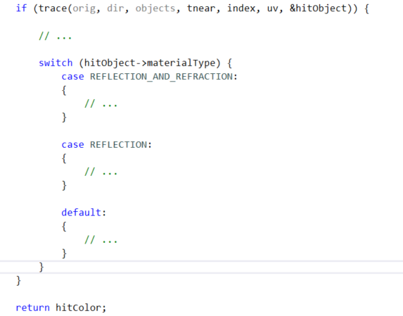
Whitted Ray-Tracing

Slide 10
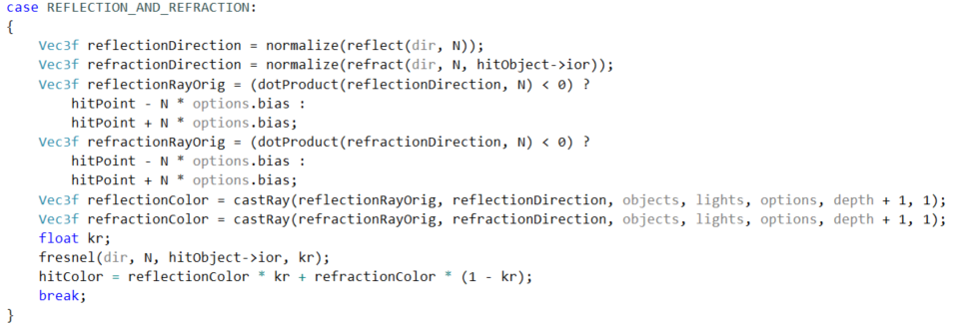
Whitted Ray-Tracing

Slide 11
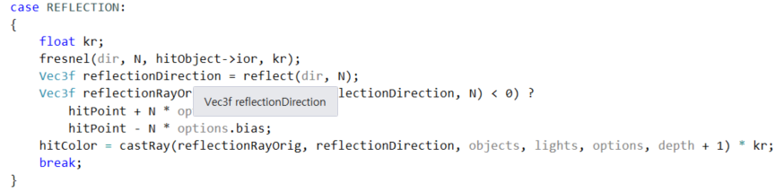
Whitted Ray-Tracing

Slide 12
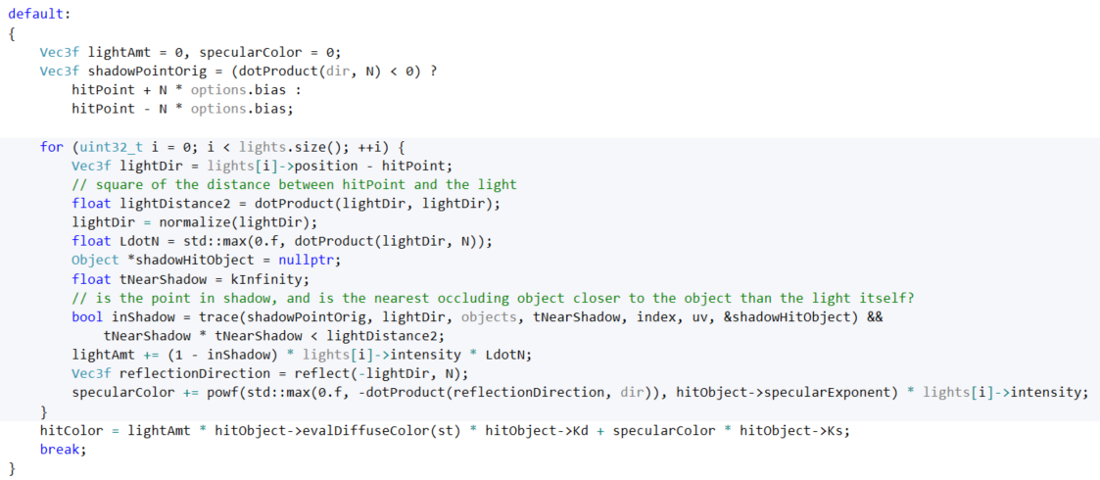
Whitted Ray-Tracing

Slide 13
Whitted Ray-Tracing

Slide 14
Whitted Ray-Tracing

Slide 15
Visibility problem
What is the visibility problem? : 뒤에 있는 면은 보이지 않는다
Which part of obj is visible from a given viewpoint <- 얘를 결정하는 문제!
Rasterisation | Ray Tracing
비용 낮음 Screen space, NDC, Raster space Depth sorting algorithm Points are projected onto the screen to find their respective position on the image plane Point on the surface -> pixel on the image plane Object -> eye | Cost computation Slow Simulating effect (reflection, soft shadows, shading, light effect …) 픽셀의 가운데에 ray를 쏘고, ray가 obj에 맞으면, 그 obj는 해당 픽셀 위치에서 보인다고 함 Eye -> object Ray 와 object의 교점을 찾는 계산이 복잡

Slide 16
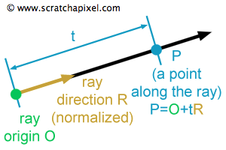
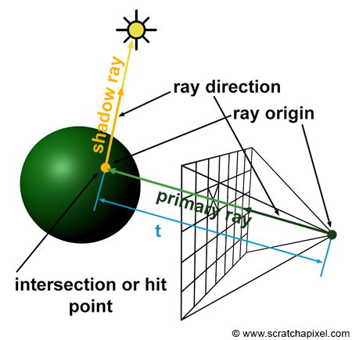
Generating Camera Rays
Ray-casting : using ray-tracing to compute visibility problem
How primary rays are generated
Primary ray = camera ray : to solve visibility
Secondary ray : to compute shadows, reflections, refractions.
(shadow ray: 교점~light / reflection / refraction: 스넬의 법칙)
렌더러: to assign a color to each pixel of the frame

Slide 17
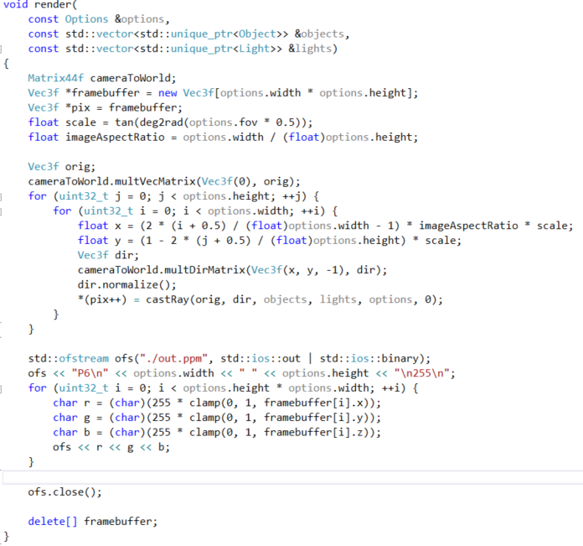
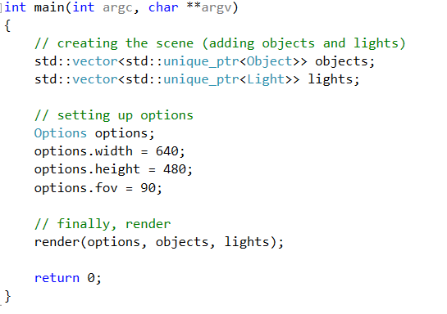
Generating Camera Rays

Slide 18
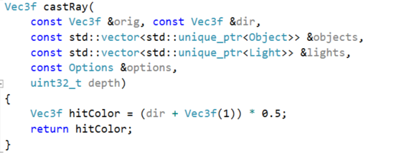
Generating Camera Rays

Slide 19
Rendering Simple Shapes
Sphere, Cube, Disk, Plane
Ray geometry intersection
How can a shape be defined mathematically? Parametric surface / implicit surface
Intersection of a ray with a sphere

Slide 20
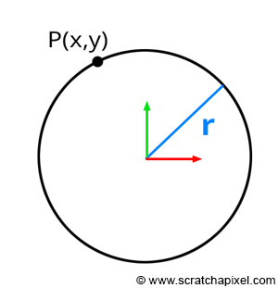
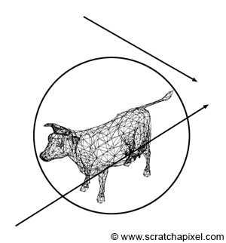
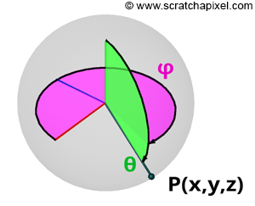
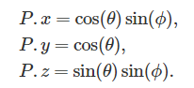
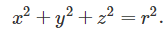
Parametric surcface, Implicit surface
Bounding volume으로 구를 사용해
각 triangle mesh와 ray의 교점을 찾기 전에
Bounding volume과 교점이 있는지부터 체크하면
렌더링에 필요한 계산량을 줄일 수 있다.
θ, ϕ : parameter

Slide 21
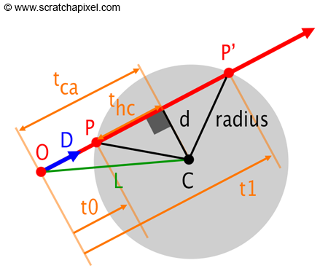
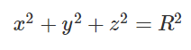
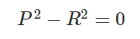
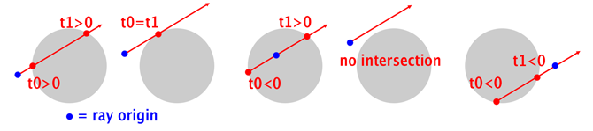
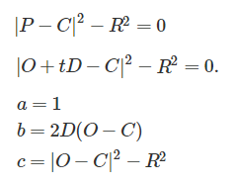
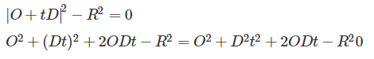
Rendering Simple Shapes

Slide 22
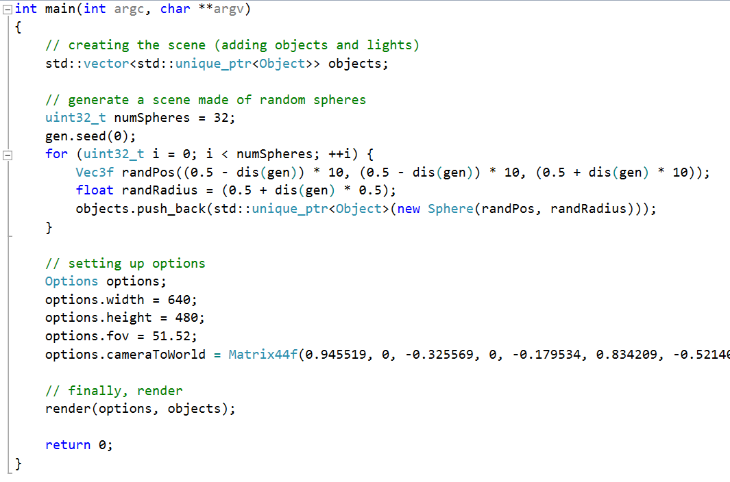
Rendering Simple Shapes

Slide 23
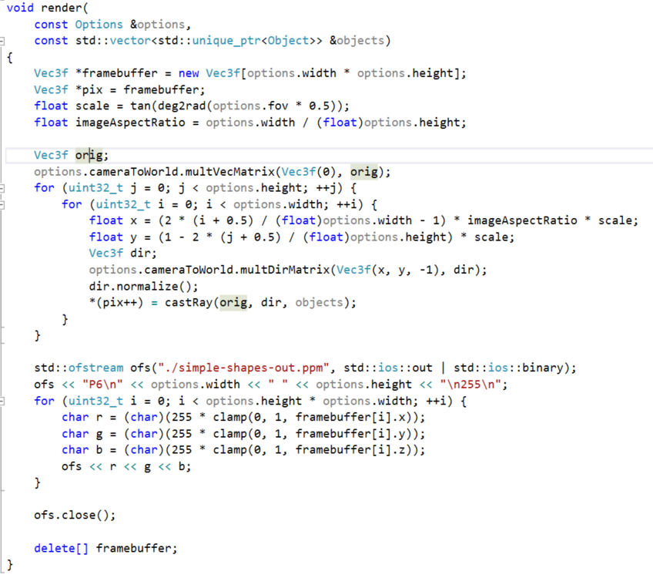
Rendering Simple Shapes

Slide 24
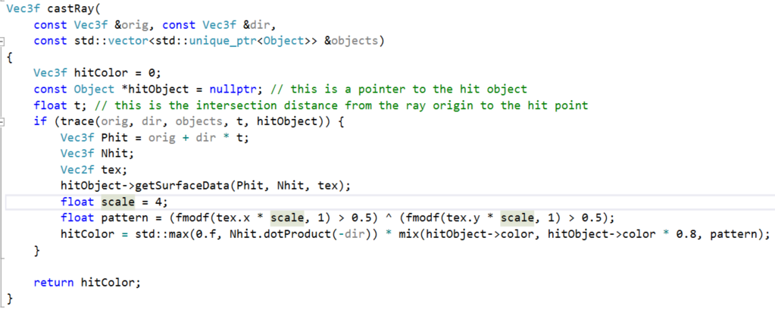
Rendering Simple Shapes

Slide 25
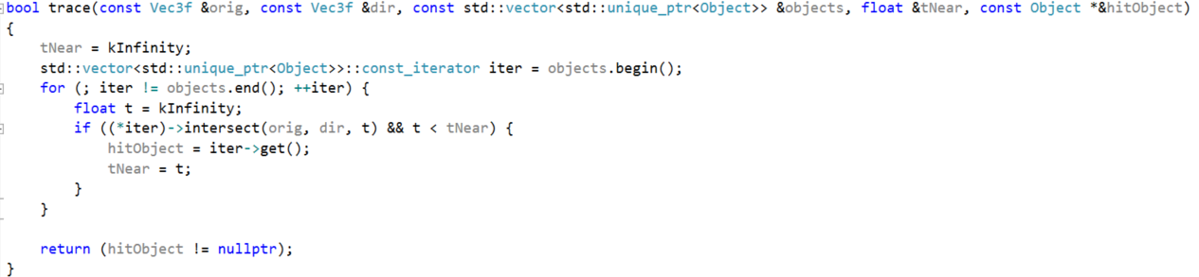
Rendering Simple Shapes

Slide 26
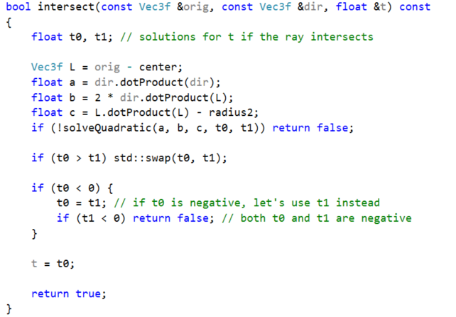
Rendering Simple Shapes

Slide 27
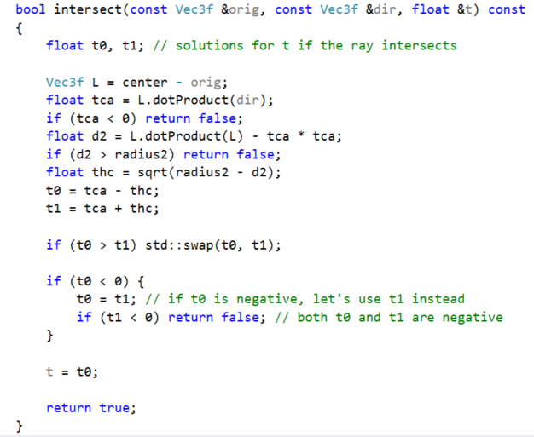
Rendering Simple Shapes

Slide 28
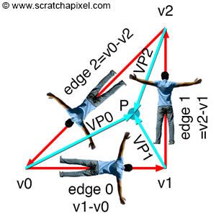
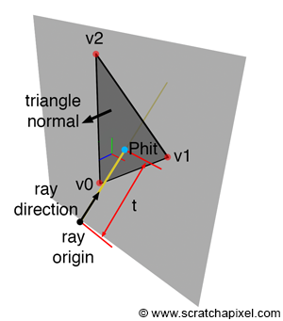
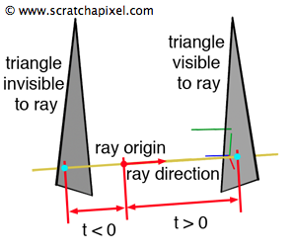
Rendering a triangle
Every object → triangle mesh
Compute intersection of a ray with every triangle in the mesh
삼각형을 포함하는 평면과 ray와 교점이 있는지 체크 (단 t>0 이어야 한다)
교점이 있다면, 그 교점이 삼각형 내부에 있는지 체크

Slide 29
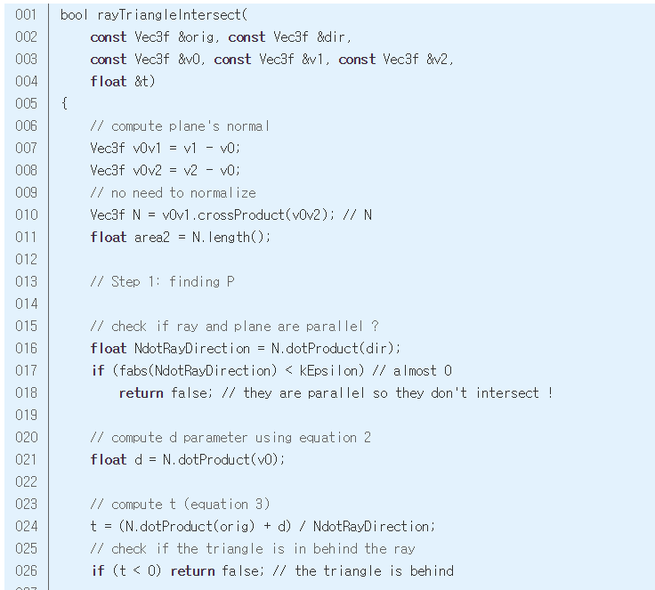
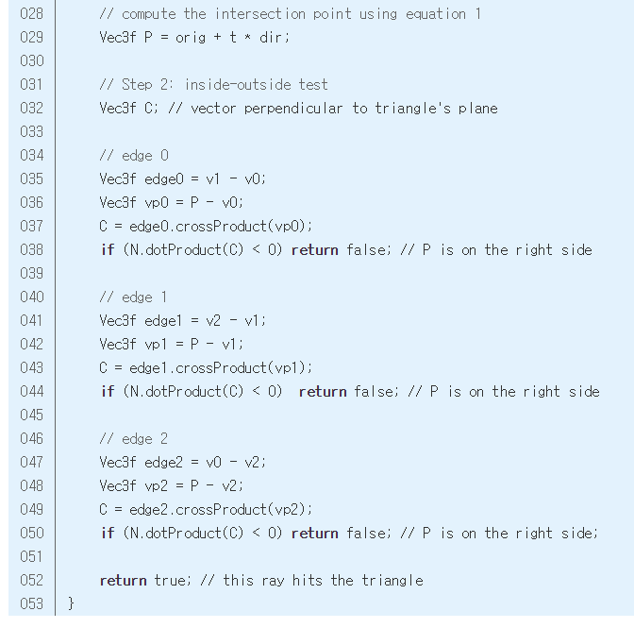

Slide 31
How to store polygon mesh data
Face Index Array | Number of vertices each face is made of | {3, 3}
Vertex Index Array | Indices of the vertices making up each face in the vertex array | {0, 2, 1, 0, 3, 2}
Vertex Array | Vertex position | {{-1,0,0}, {0,1,0}, {1,0,0}, {0,-1,0}}
Texture Index Array (optional) | Indices of the vertices making up each face in the texture coordinates array | {0, 2, 1, 0, 3, 2}
Texture Coordinates Array | Vertex position in uv-space | {{0,0.5}, {0.5,1}, {1,0.5}, {0.5,0}} or 6 coordinates if you don't use a texture index array {{0,0.5}, {1,0.5}, {0.5,1}, {0,0.5}, {0.5,0}, {1,0.5}}

Slide 32
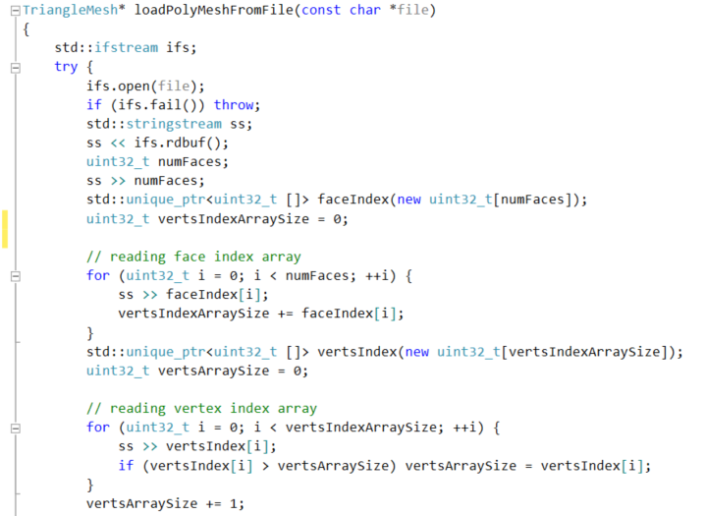
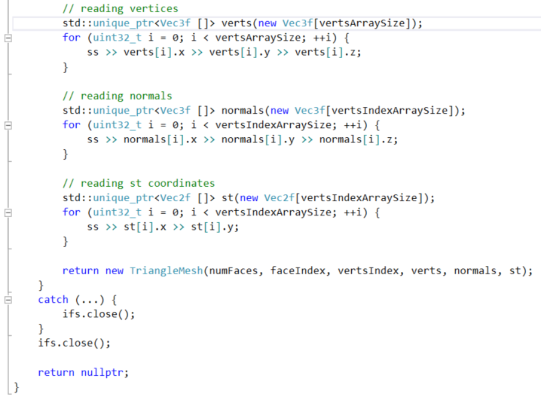
How to store polygon mesh data

Slide 33
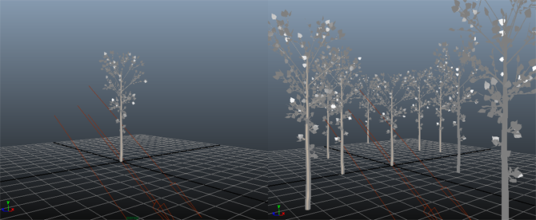
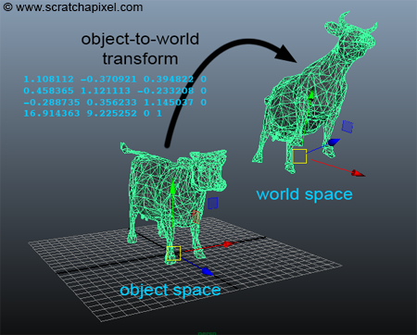
Transforming Objects using Matrices
We change the size, the rotation and the position of object using a 4x4 transformation matrix
That matrix : object-to-world matrix (in OpenGL, model matrix).
Object space world space

Slide 34
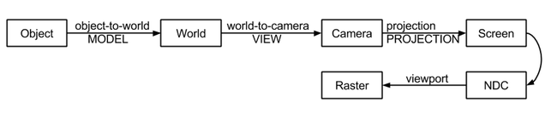
Transformation pipeline
Objects are first transformed from object space to world space.
If rasterization is used, objects are then transform from world-to-camera space.
Vertices are then projected onto the screen (using the perspective projection matrix) to screen space
And then remapped to NDC (as part of the perspective projection matrix).
Finally, points on the image plane in NDC coordinates are converted to their final raster or pixel coordinates.

Slide 35
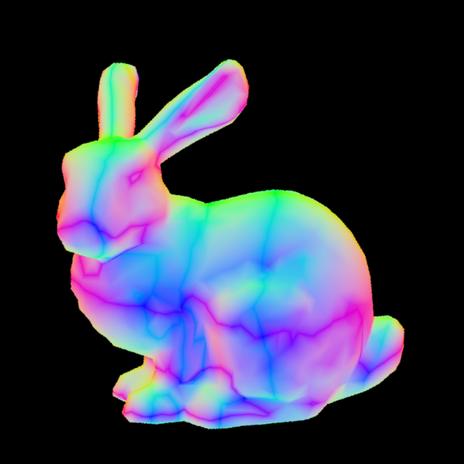

Normal vector, Bunny.obj rendering

Slide 36
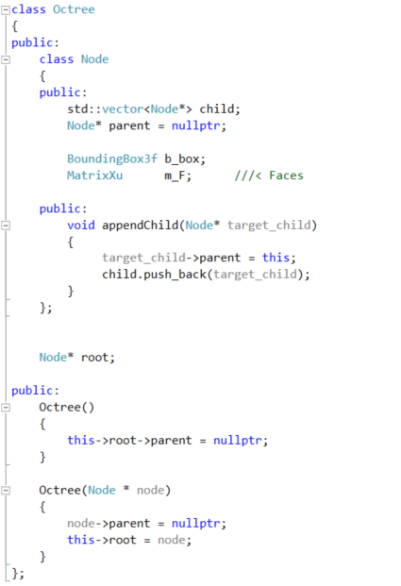
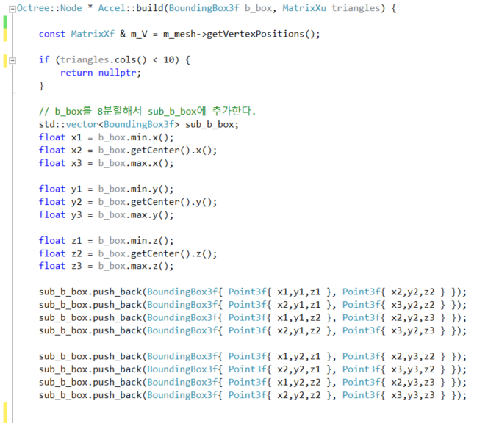
Octree Construction(1)

Slide 37
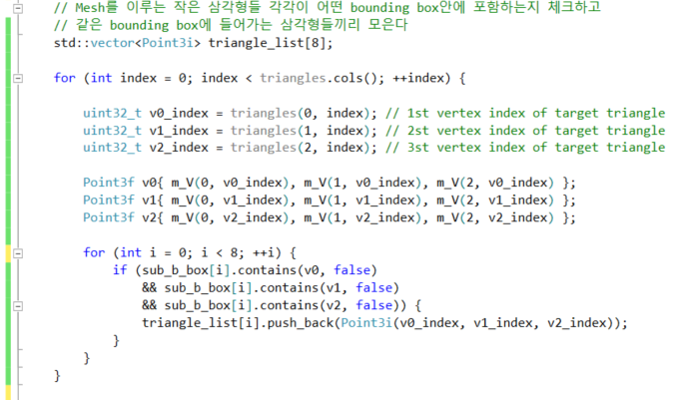
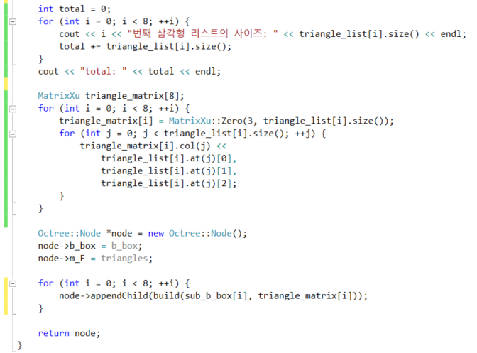
Octree Construction(1)

Slide 38
Octree Construction(1)
문제점
속도가 너무 느림
std::vector : 메모리 할당하고 지워주는 과정이 느리게 만드는 요소
→ int[N] 배열을 하나만 만들고, 이 안에서 소팅해서
각 노드는 인덱스만 저장할 수 있도록 하는 방법이 없을까…?
2) 삼각형의 개수를 모두 세지 못함
v0, v1, v2를 모두 포함하는 bounding box를 계산하면 포함되지 않는 삼각형들이 생긴다
→ 세점의 centroid를 포함하는지만 체크하자
→

Slide 40
향후 계획
알고리즘 공부
C++ 공부
OpenGL / DirectX / Unreal 공부 ..?
그래픽스의 다양한 분야(ex. 시뮬레이션?)를 찾아보면서 제일 재밌게 느껴지는 분야 찾기

